Slide 1
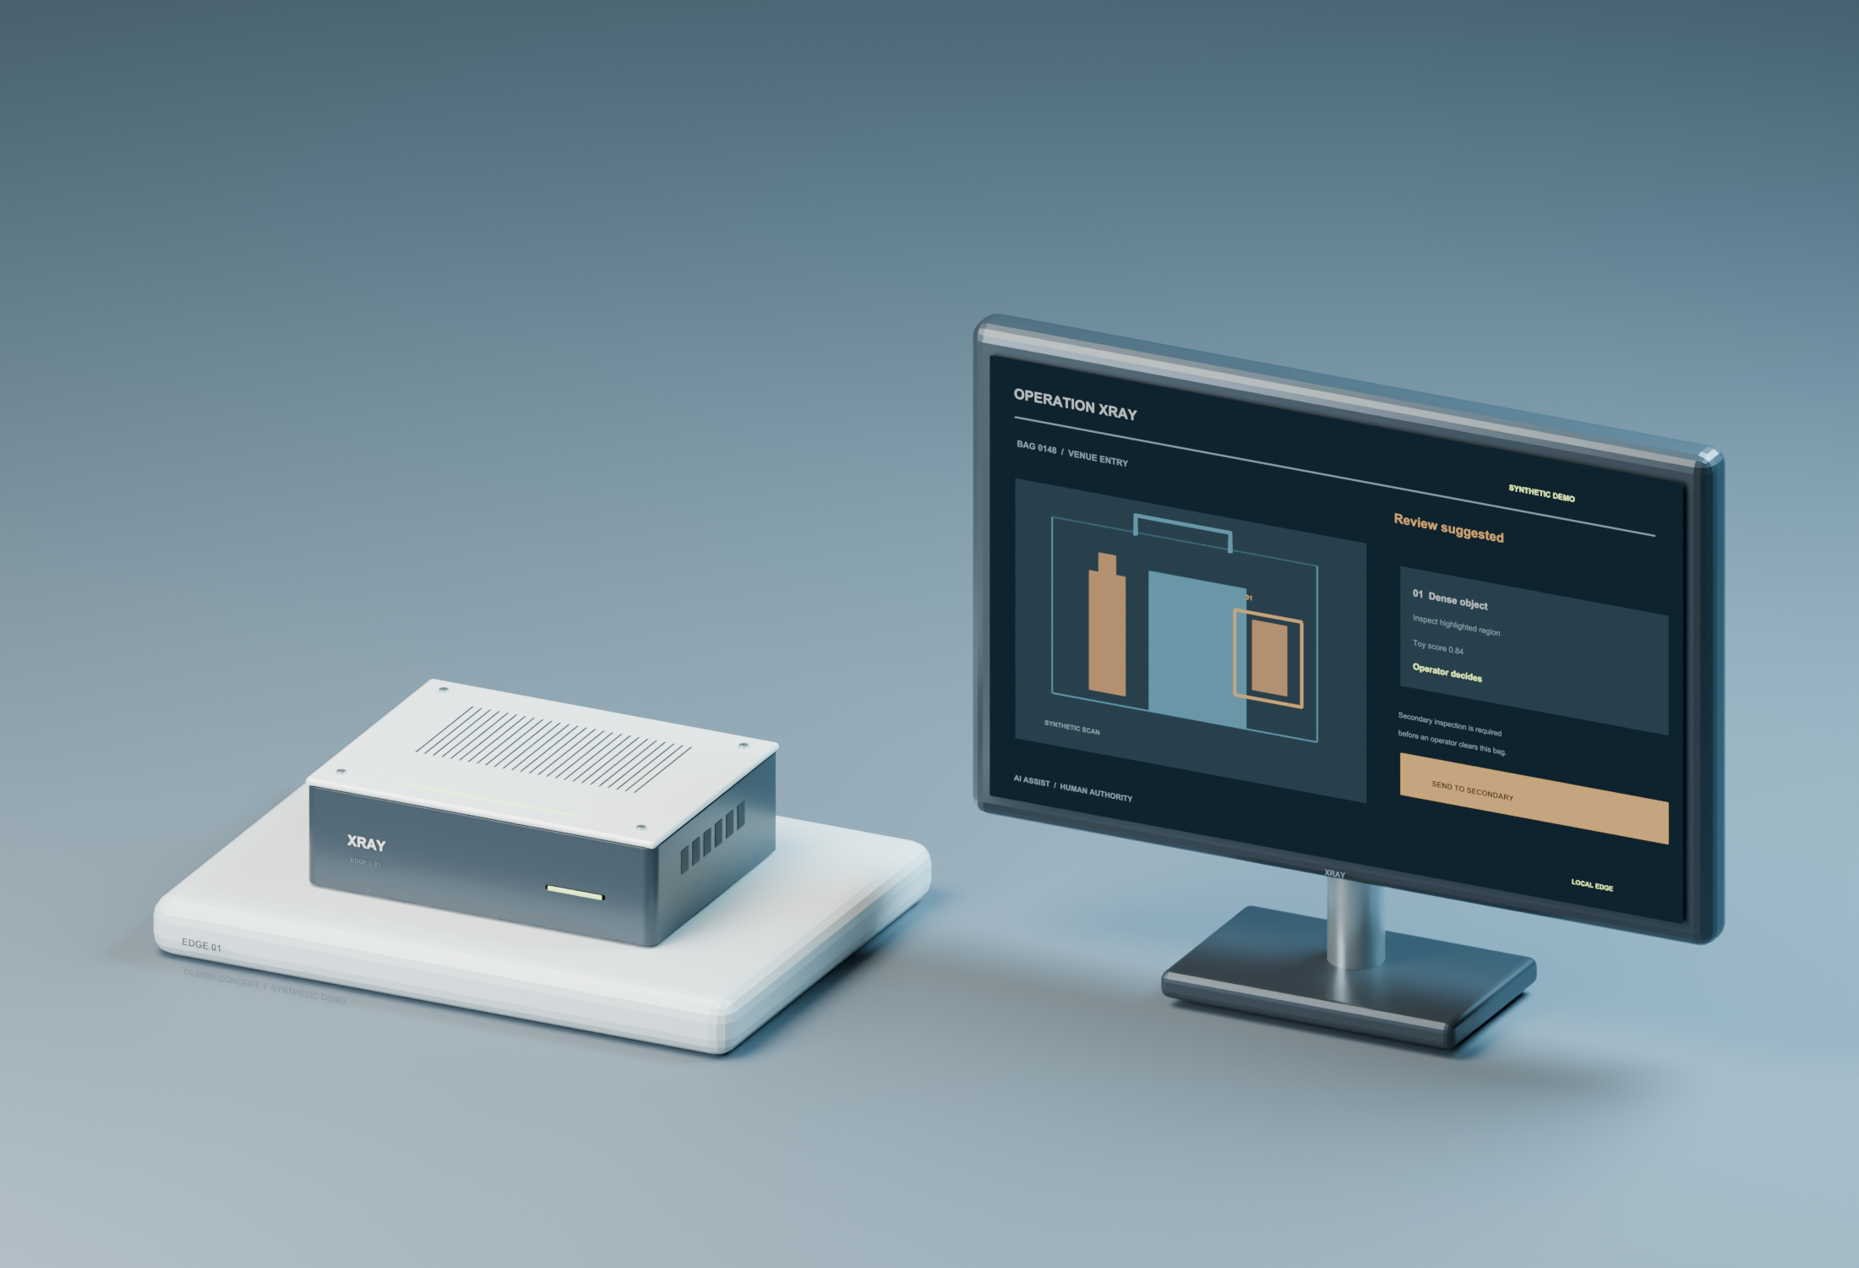
Operation
Xray
AI assistance for
venue bag screening
A second view for the human
responsible for the decision
OPERATION XRAY 01
Concept prototype and proposed validation plan October 11, 2026
Notes:
Opening: Operation Xray proposes an AI copilot for venue bag screening. The human owns every screening decision. This is a concept package with synthetic software examples and industrial design renders. It is not a trained security detector or operational X-ray system. We seek capital and technical partners to validate image access, detection performance, human factors, and commercial demand. The name and identity are working product branding. Render: original Operation Xray concept CAD artwork created for this package.
Sources checked October 11, 2026:

Slide 2
Venue bag screening
Every bag still needs
a human judgment
Initial buyer
Venue security director or
contracted screening operator
Concerts and sporting events are the first use case.
We target sites that already operate cabinet X-ray scanners.
Discovery questions
Where do reviews slow down?
Which alerts earn trust?
What does a useful audit show?
OPERATION XRAY 02
Buyer and problem hypotheses. Customer interviews remain pending.
Notes:
Problem hypothesis: an operator has to interpret cluttered bag imagery while applying venue policies and resolving possible concerns. We have not measured an operator error rate, queue impact, or ROI. Interviews and observation must establish whether a copilot solves a sufficiently painful problem. The first buyer experiment targets existing scanner users because image access and integration are prerequisites. Bag inspection is distinct from scanning a person. The prototype does not profile people or assess intent. FDA explains that cabinet systems provide images of parcels and luggage, and exclude people from the radiation space. Proposed discovery target: interview 20 buyers and 5 OEMs or integrators, not activity already completed.
Sources checked October 11, 2026:
https://www.fda.gov/radiation-emitting-products/security-systems/cabinet-x-ray-systems-closed-x-ray-systems

Slide 3
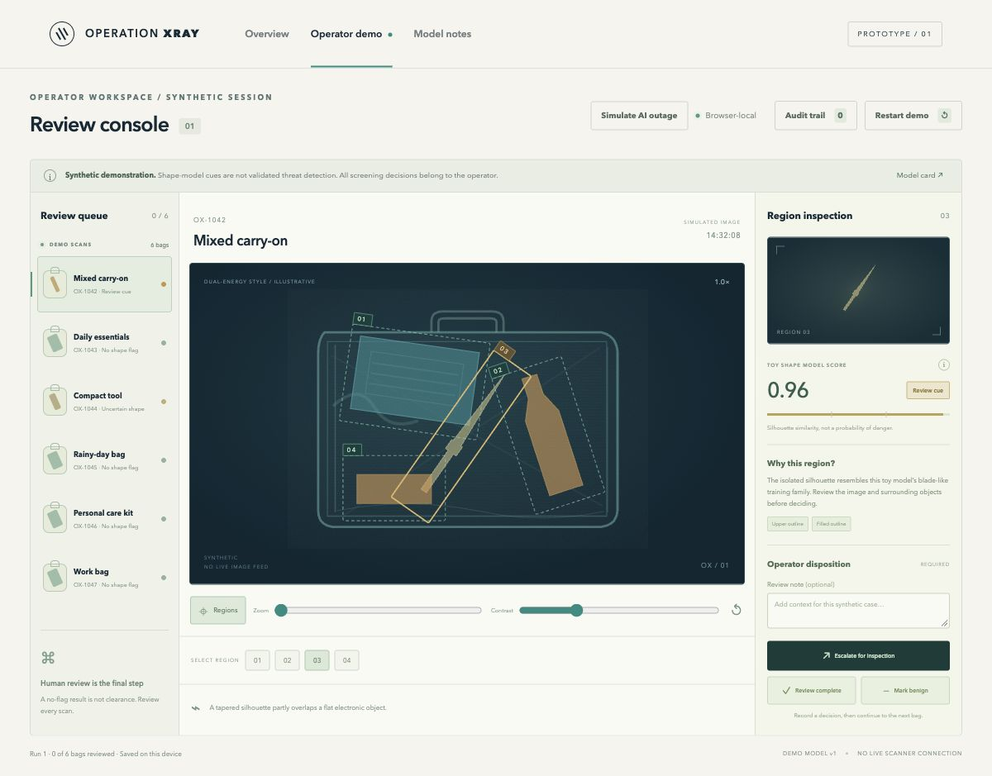
A second view for the operator
Inspect
Review the original image
and suggested region.
Resolve
Record a human decision.
Keep the reason in the audit.
The copilot never
automatically clears a bag
OPERATION XRAY 03
Synthetic demo. Suggestions and model scores do not establish real-world detection.
Notes:
Demonstrate the local interface. It uses synthetic scan-like artwork and a toy shape classifier. Any displayed confidence is a synthetic-model score, not a probability of a real threat. Click a flagged region, review the explanation, and record a human disposition. Demonstrate an ambiguous example, a benign-looking example, and model unavailable. The audit records the operator action. The workflow prototype shows how a suggestion can connect to review and traceability, not that it improves detection. Use the separate demo-script.md for the precise sequence. Screenshot: local Operation Xray interface generated for this package.
Sources checked October 11, 2026:

Slide 4
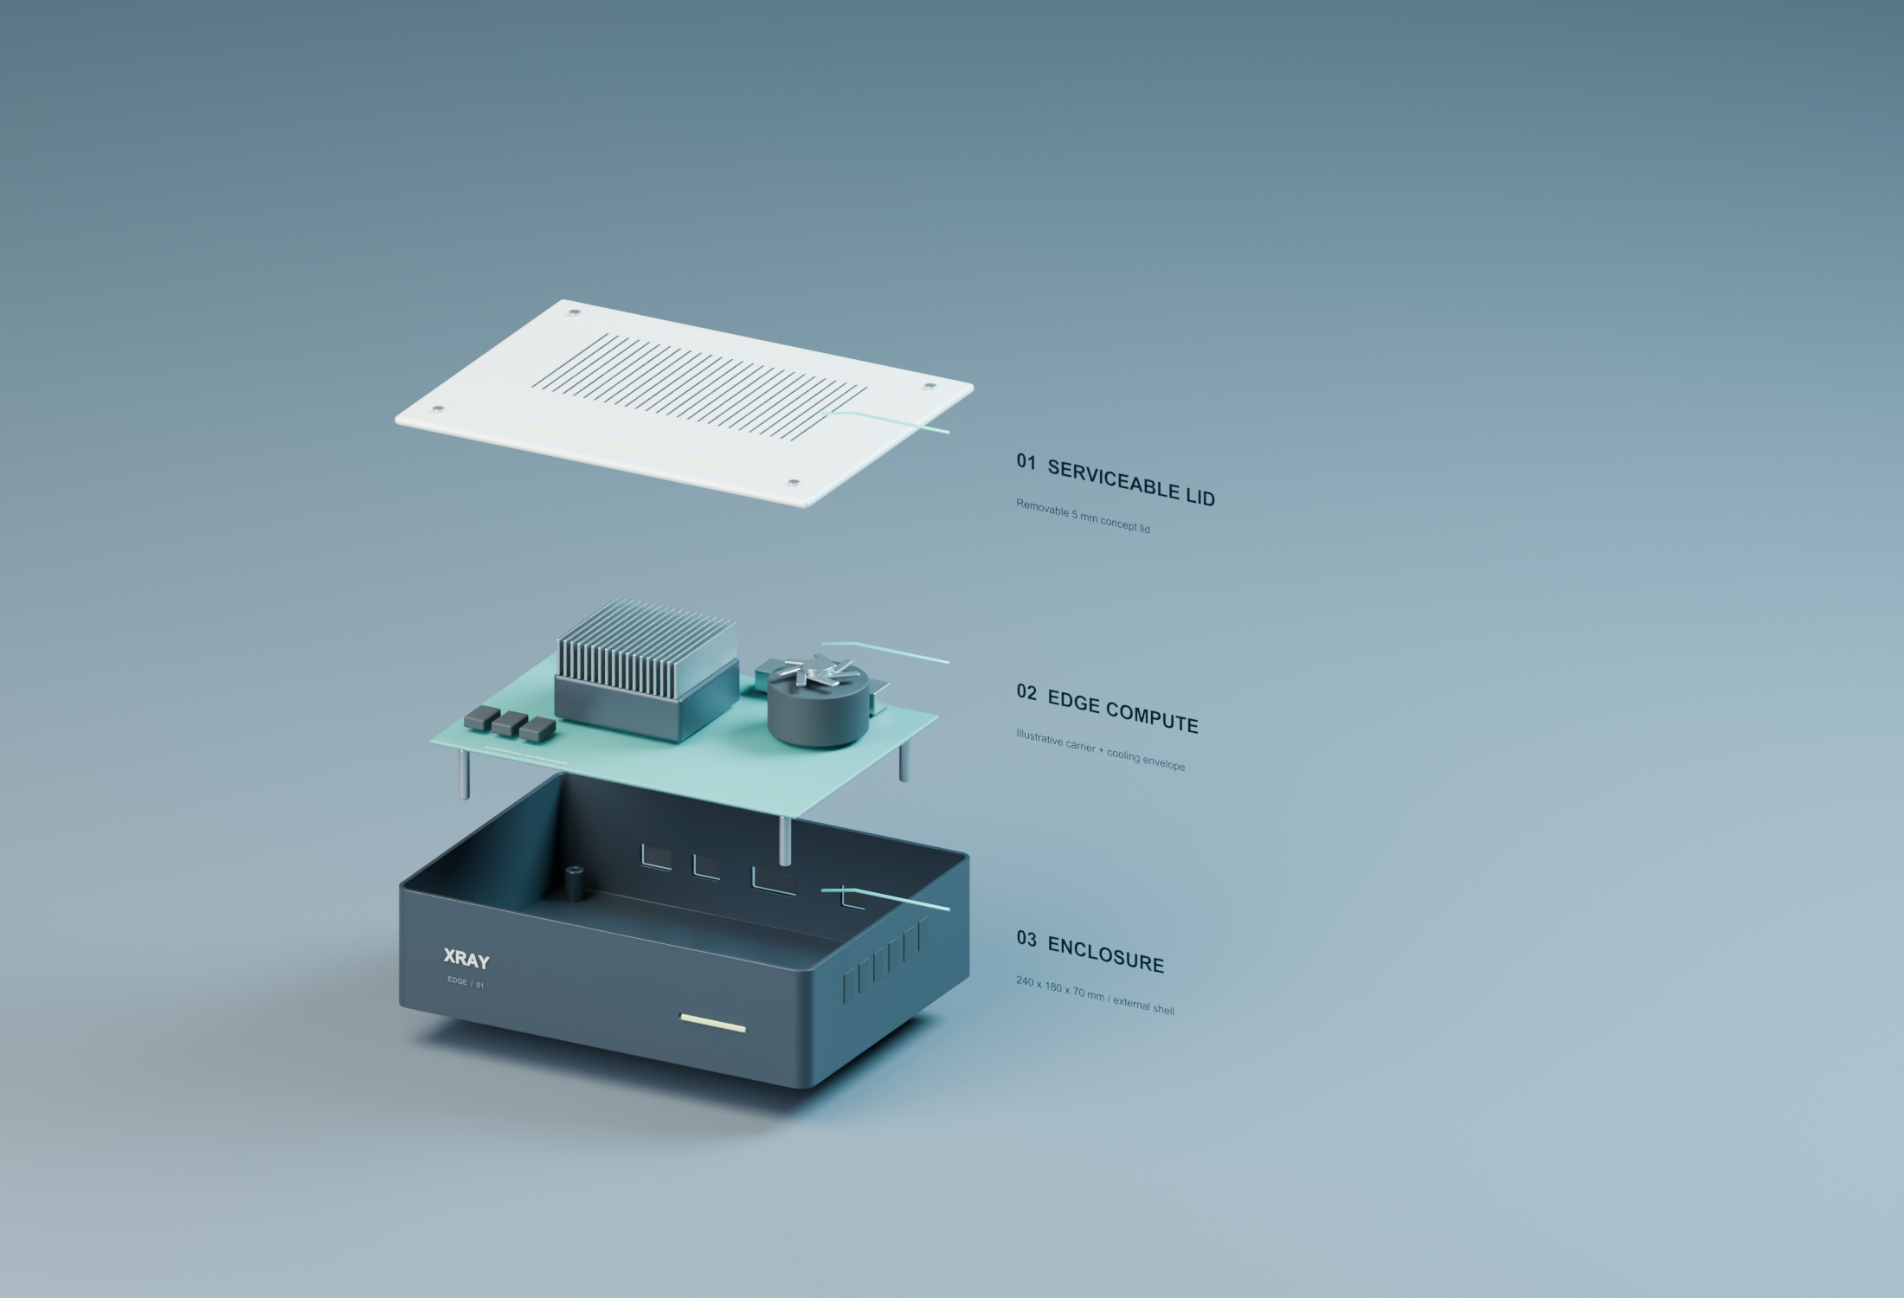
Retrofit architecture
01
Approved image feed
One scanner model with documented export access
02
Edge analysis
Versioned inference and explicit unavailable states
03
Operator console
Original image, suggested region, human disposition
04
Audit record
Scan ID, model version, decision, and reason
OPERATION XRAY 04
Proposed integration requires a licensed feed, OEM cooperation, and safety review.
Notes:
Architecture is proposed. Keep the imaging path separate from scanner controls. The image interface must provide authorized data with stable scan identifiers and acquisition metadata, rather than an uncontrolled screen scrape. The edge service would run a validated vision model locally and present suggestions with explicit quality and availability states. The original scanner and standard operating procedure continue when the copilot is unavailable. The CAD is a form and integration concept, not radiation engineering. OEM and specialist review must determine any implications for the certified equipment and regulated performance. FDA guidance states that relevant system modifications can trigger manufacturing obligations. Do not claim universal scanner compatibility. Render: original concept assembly and enclosure artwork.
Sources checked October 11, 2026:
https://www.fda.gov/regulatory-information/search-fda-guidance-documents/compliance-guide-cabinet-x-ray-systems

Slide 5
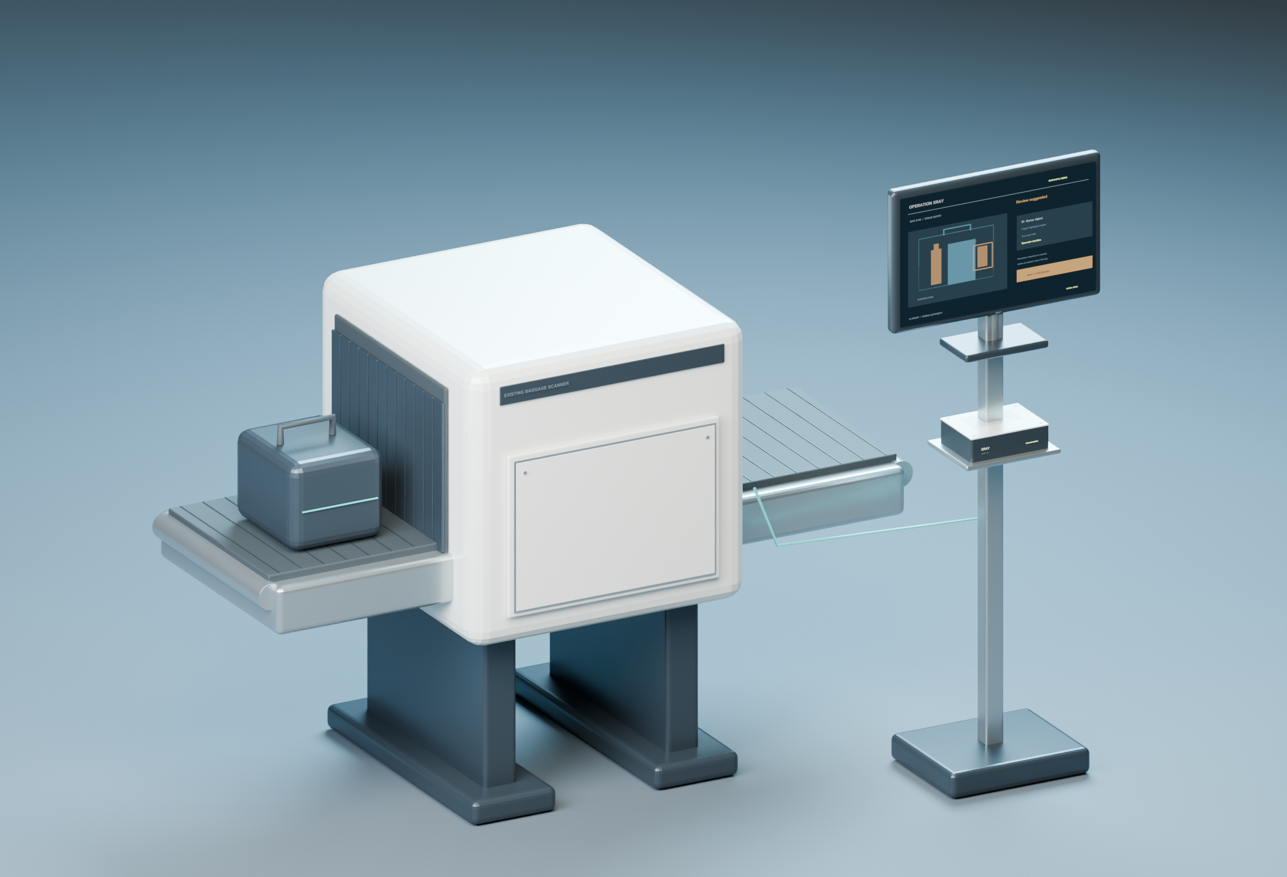
What the prototype proves
Available today
Editable 3D concept
Interactive operator workflow
Toy inference on synthetic artwork
Exportable decision audit
Evidence still required
Licensed scans and an OEM interface
Independent detection evaluation
Buyer demand and pilot economics
OPERATION XRAY 05
Current stage: concept and synthetic workflow. No real scanner or clinical validation.
Notes:
The prototype makes the vision tangible and reviewable. The 3D form illustrates an edge appliance and operator station near an existing scanner. Software exercises a review queue, a region indication, human disposition, and audit export. A toy classifier demonstrates the inference interface on synthetic shape artwork. None of these artifacts is evidence of operational security performance. We do not have verified customers, deployment approvals, scanner contracts, or proprietary image data. The next stage is a partner-backed experiment. Render: original Operation Xray integration concept created for this package.
Sources checked October 11, 2026:

Slide 6
Competition and our hypothesis
Provider | Existing capability | Implication for our plan
Smiths Detection iCMORE | AI prohibited-item recognition. Upgrades to Smiths systems. | Retrofit AI already exists. A generic overlay is insufficient.
Rapiscan Systems and AS&E | Operator assistance in ORION. InSight ML in cargo / vehicles. | Incumbents own integration and service relationships.
Operation Xray Proposed | Venue policy and human review workflow across approved integrations. | Differentiation requires buyer evidence and OEM access.
Validation question
Will venues pay for an integrated review and audit workflow beyond their OEM software?
OPERATION XRAY 06
Official product descriptions. No comparative performance testing has been conducted.
Notes:
Smiths advertises iCMORE prohibited-item AI and upgrades for existing Smiths scanners, with possible hardware needs by type and age. Rapiscan describes operator assistance and networking for ORION 928DX. Rapiscan AS&E advertises InSight ML and deep learning for cargo and vehicle analytics. Product markets differ, so this is not a like-for-like benchmark. These sources show a mature competitive starting point. Our hypothesis is a venue-focused workflow with configurable policy, documented scanner integration, and useful evidence for supervisors. These features may also exist in competitor products. Validate them in customer discovery and a current feature comparison. Defensibility could come from licensed data, evaluated human workflow, and partner distribution, but none is secured.
Sources checked October 11, 2026:
https://www.smithsdetection.com/icmore-prohibited-items/
https://www.smithsdetection.com/icmore/
https://rapiscansystems.com/en/products/orion-928dx
https://www.rapiscan-ase.com/resource-center/technology

Slide 7
Business model to test
$900
Monthly per lane | Scenario
Revenue | $900
Recurring variable cost | $180
Contribution before fixed costs | $720
Modeled recurring gross margin | 80%
per active lane / month
Recurring copilot subscription.
Edge kit and installation priced separately.
100 active lanes = $1.08m ARR
Unknown: OEM fees, support burden,
CAC, sales cycle, renewals, and churn
OPERATION XRAY 07
Illustrative planning inputs. Prices, costs, and margins are unvalidated.
Notes:
This is a pricing experiment and arithmetic scenario, not an actual quote, revenue, forecast, TAM, or margin performance. Revenue assumes $900 monthly per active lane. Variable cost assumes $70 for compute/update delivery/storage, $80 direct support allocation, and $30 service/replacement reserve. $900 minus $180 equals $720 contribution and 80 percent recurring gross margin if those are the complete recurring costs of goods sold. OEM licensing, channel fees, kit amortization, insurance, service levels, and actual support can change the result. Fixed engineering and sales expenses are excluded. 100 lanes times $900 times 12 equals $1.08 million annual recurring revenue. Seasonal pricing should be tested. One-time kit/install scenario: $4,500 price against $3,500 assumed cost. CAC, churn, LTV, and renewal rates are unknown. Partner-led installation and annual subscriptions are commercial hypotheses.
Sources checked October 11, 2026:

Slide 8
Data access comes before deployment
A usable dataset needs
permission and ground truth
External holdout
Keep unseen bags, sessions,
sites, and scanners for evaluation.
OEM + venue agreement
Human + copilot study
Image export access. Training and pilot rights.
Retention, security, and incident procedures.
Measure sensitivity by class,
false alerts, review time,
automation bias, and outages.
Independent annotation
Qualified screeners adjudicate labels.
OPERATION XRAY 08
Proposed research plan. Synthetic demo images are unsuitable for deployment claims.
Notes:
The hardest prerequisite is access to representative scans with lawful training and pilot rights. Ask one OEM and venue to agree on a bounded taxonomy and a supervised collection protocol. Include benign clutter and realistic orientations, with permission to stage controlled examples. Screeners annotate and independently adjudicate labels. Deduplicate and split by bag/session/site to avoid leakage, preserving an untouched external holdout. Evaluate per-class sensitivity with confidence intervals, false alerts per bag and operator-hour, quality failures, and P95 latency. Then compare the same human workflow with and without the copilot in a balanced study. Measure automation bias and unnecessary searches, not only speed. Performance thresholds and sample size require baseline prevalence and partner requirements and should be registered before tuning. No values in this package establish a safety threshold. Stop if lawful access or reliable integration cannot be secured.
Sources checked October 11, 2026:

Slide 9
18-month validation plan
Period | Work | Evidence required to advance
Months 0-3 | Buyer discovery OEM feasibility | Signed data rights and a credible integration path for one scanner
Months 4-6 | Data collection Lab integration | Representative labeled scans and an independent evaluation plan
Months 7-12 | Holdout study Supervised shadow pilots | Detection and human-factor evidence against pre-registered partner criteria
Months 13-18 | Paid pilot decision Delivery economics | Independent report and customer decision with verified costs, or a stop / pivot
Next-round evidence: independently evaluated results and a paid customer decision.
OPERATION XRAY 09
Proposed milestones after funding. Progress depends on partner access and study results.
Notes:
Months are targets counted after funding, not fixed calendar commitments. First verify the buyer need and OEM image access. Then collect and label real data before model development claims. The lab stage defines quality and failure behavior and a preregistered evaluation protocol. Shadow pilots run beside the existing process without changing operational screening decisions. Independent review should establish class-specific detection bounds, acceptable alert burden, human performance and review-time outcomes, and recovery from outages. Partners and domain experts must set the numerical criteria and sample sizes. Stage four seeks a paid customer decision and full delivery costs. Two contracted shadow venue pilots are a target, not commitments. If access, performance, or willingness to pay fails, stop or narrow the product rather than assume scale.
Sources checked October 11, 2026:

Slide 10
Proposed pre-seed round
$1.5m
Use of funds | Amount
Engineering and domain team | $600k
Data, annotation, OEM lab | $270k
Venue pilots and field work | $180k
Evaluation, security, legal | $150k
Product infrastructure | $150k
Contingency | $150k
Total | $1,500k
18 months to validate
One approved scanner integration.
Independent detection evaluation.
A paid customer decision.
No custom scanner manufacture
in this proposed budget
OPERATION XRAY 10
Illustrative $1.5m budget. No financing commitments or guaranteed runway.
Notes:
Ask: an illustrative $1.5 million pre-seed to pursue an 18-month validation plan. The budget assigns $600,000 or 40 percent to a lean engineering and domain team, $270,000 or 18 percent to data access, annotation, and OEM lab work, $180,000 or 12 percent to venue pilot operations, $150,000 or 10 percent to independent evaluation/security/legal, $150,000 or 10 percent to product infrastructure, and $150,000 or 10 percent contingency. Total equals $1.5 million. This assumes fractional domain expertise and no new X-ray scanner manufacturing. Compensation, vendor, legal, and insurance quotes are required to validate runway. Funds should support a gate-based program. Team credentials, founder ownership, fundraising terms, and valuation remain for the founder to define. The investor case depends on access to data and differentiation, not claimed traction.
Sources checked October 11, 2026:

Slide 11
Airport and clinical expansion
Airport bag screening
MRI findings assistance
A later aviation product
A separate clinical product
Needs application-specific testing,
approved integration, and an
acquisition pathway.
MRI uses magnetic fields and
radiofrequency energy. It does
not use ionizing X-rays.
TSA demonstration access does
not establish procurement or approval.
Needs clinical partners, modality data,
validation, and a regulatory pathway.
OPERATION XRAY 11
Later options. No airport or medical revenue appears in the near-term plan.
Notes:
The founder vision includes airports and medical imaging, but each requires a different evidence program. TSA describes assessment and demonstrations through its Innovation Task Force. Airport integration also has checkpoint equipment and program requirements. This does not imply Operation Xray has qualification, access, or procurement. MRI is distinct: FDA states MR images use no ionizing radiation. A clinical image copilot needs a narrow clinical indication, clinical datasets, radiologist partners, patient-data governance, prospective evaluation, and a determined regulatory pathway. FDA explains that analyzing medical images does not satisfy the first criterion for the non-device clinical decision support exclusion. A human remaining in the loop does not automatically remove medical-device obligations. A clinical business would need separate capital planning. The deck makes no diagnostic claims.
Sources checked October 11, 2026:
https://www.tsa.gov/sites/default/files/itf-postcard_0.pdf
https://www.tsa.gov/sites/default/files/checkpoint-requirements-and-planning-guide.pdf
https://www.fda.gov/radiation-emitting-products/mri-magnetic-resonance-imaging/benefits-and-risks
https://www.fda.gov/medical-devices/digital-health-center-excellence/step-6-software-function-intended-provide-clinical-decision-support

Slide 12
The next evidence
Before an investment decision
Primary sources
Who will own the OEM and security relationships?
Can we license real scans for training and pilots?
Will buyers pay beyond their incumbent software?
Can independent trials show a useful human benefit?
Smiths iCMORE
Smiths upgrade compatibility
Rapiscan ML / deep learning
FDA cabinet X-ray guidance
TSA innovation demonstrations
FDA MRI modality
Current evidence boundary
FDA clinical software criteria
Concept CAD and synthetic workflow only.
Customers, performance, approvals, and revenue remain unverified.
OPERATION XRAY 12
Diligence appendix. Sources checked October 11, 2026. Full source register accompanies this deck.
Notes:
Use this as the diligence close. Operation Xray seeks a discussion around a staged research and commercial program. No interviews, contracts, pilots, image licenses, OEM relationships, performance measurements, approvals, revenue, or proprietary data have been verified. The founder must define the company and founding team. The specific hires and advisors should support scanner integration, detection evaluation, operational security, and enterprise sales. Source links on this slide and the speaker notes are primary sources. Vendor descriptions are not comparative test data. Review the accompanying research-and-assumptions.md for details, calculations, and gaps. Full source register follows.
Sources checked October 11, 2026:
https://www.smithsdetection.com/icmore-prohibited-items/
https://www.smithsdetection.com/icmore/
https://www.rapiscan-ase.com/resource-center/technology
https://rapiscansystems.com/en/products/orion-928dx
https://www.fda.gov/radiation-emitting-products/security-systems/cabinet-x-ray-systems-closed-x-ray-systems
https://www.fda.gov/regulatory-information/search-fda-guidance-documents/compliance-guide-cabinet-x-ray-systems
https://www.tsa.gov/sites/default/files/itf-postcard_0.pdf
https://www.tsa.gov/sites/default/files/checkpoint-requirements-and-planning-guide.pdf
https://www.fda.gov/radiation-emitting-products/mri-magnetic-resonance-imaging/benefits-and-risks
https://www.fda.gov/medical-devices/digital-health-center-excellence/step-6-software-function-intended-provide-clinical-decision-support

